Slide 1
8.5

Slide 2
Concept
Tokenizing a string is a process of breaking a string down into components which are called tokens. The StringTokenizer class and the string class split method can be used to tokenize strings.

Slide 3
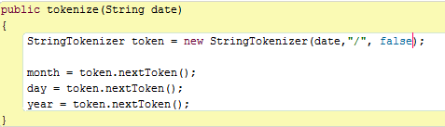

The StringTokenizer Class
Import java.util.StringTokenizer;
StringTokenizer (String str, String delimiters, Boolean returnDelimeters)
By default space, tab, and new lines are delimiters and return delimiters are set to false.

Slide 4
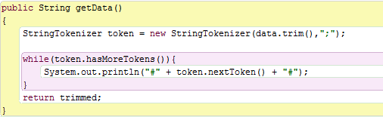
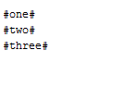
Trimming A String
Used to remove leading and trailing white space.

Slide 5
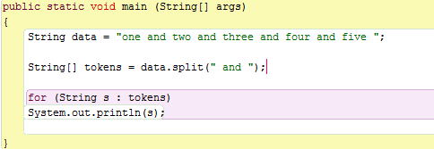

String Class Split Method
Tokenize a String and returns an array of String objects

